Slide 1
A mini project on House grades classification
presented by:-
Narmula vamshikrishna

Slide 2
Business goal:-
To predict the different Grades of the house using the past data.
The Grades for the houses are given based on different features.
By analyzing the past data we have to build the model to predict the Grades of the house using different features given in the dataset.
By analyzing we can help the customers choose the required based on their requirement.

Slide 3
Eda process:-
Loading the data and reading the data.
Check for the structure.
Check for the datatypes
Check for information
Check for summary
Check for null values.
No null values in the given dataset.
Checked for any special characters present in the data found no special characters.
Data Visualization.

Slide 4
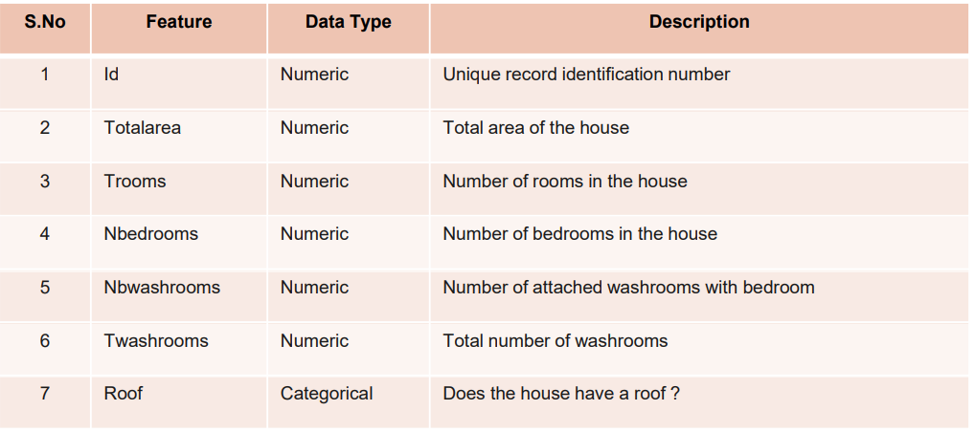
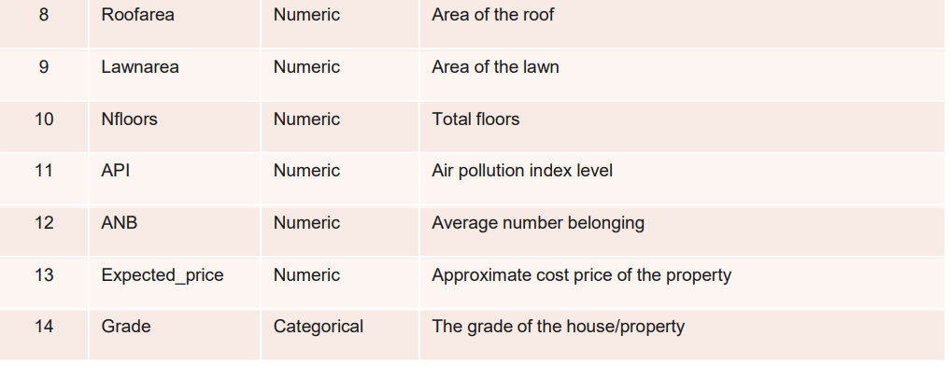
Data source and datatypes
The structure of the given dataset :
Rows = 3000
Columns = 13
Here the Feature ‘Id’ was dropped and analysed further.
The datatypes of the 13 features are shown in the picture which has
11 – Numeric columns
2 – Non_Numeric Columns

Slide 5
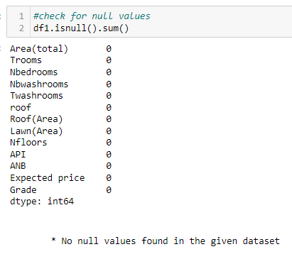
Data preprocessing : Imputation of missing values
Check for the Null values in the given dataset.
There are no null values in the given dataset.
Check for Special characters in the given dataset.
There are no special characters in the given dataset.
Outlier Treatment for the given dataset.
There were no outliers found in the given dataset as
I used boxplot to check for outliers.

Slide 6
Feature engineering Techniques
Converting the non-numeric columns to categorical columns.
Using labelencoder converting the categorical columns to numerical columns.
Using standardization scaling the data
Finding the correlation of scaled features with for the dependent feature.
Feature selection based on the correlation with the dependent feature above 10% and features that are highly intercorrelated are not considered.
After feature selection specified the data into independent ‘X1’ and dependent ‘y1’.
Using the cross validation technique and ‘STRATIFIEDKFOLD’ split technique the data is further splitted in the process of model building and evaluation.

Slide 7
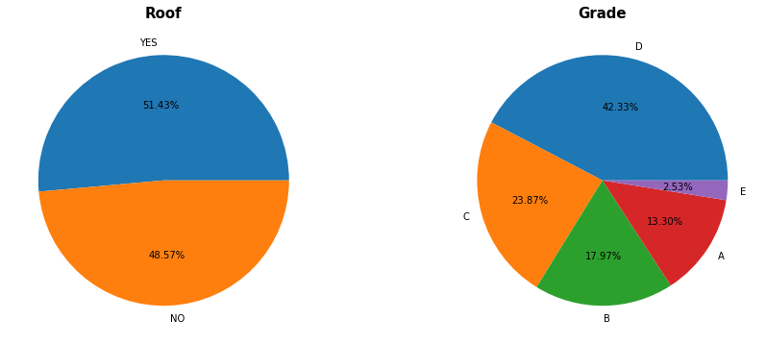
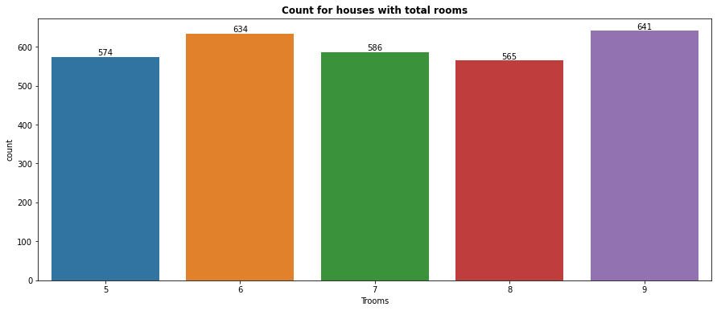
Visualizations:-
UNIVARIATE
Interpretation:-
There are more Houses with Roof that is 51.43% and without Roof that is 48.57%.
There are more number of Houses with ‘Grade-D’ as 42.33% and least is ‘Grade-E’ as 2.53%.
There are more number of houses with Totalrooms of ‘6’ followed by Totalrooms of ‘9’.

Slide 8
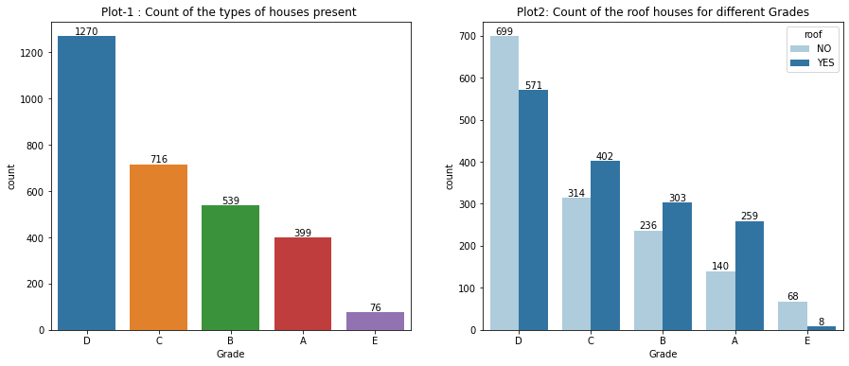
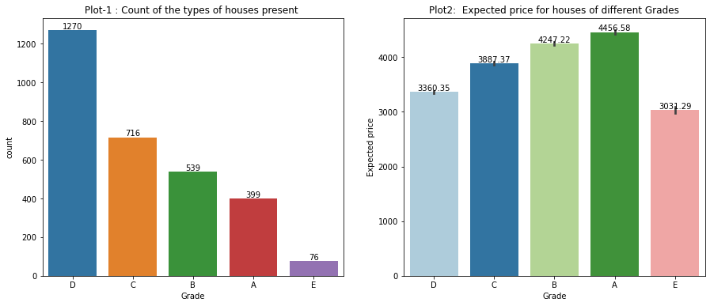
BIVARIATE
Interpretation:-
There are more number of houses with Grade-D in which Houses without roof are more compared to houses with roof.
The houses with Grades like C,B and A have more houses with roof compared to houses without roof and least houses in Grade E.
The Expected prices for the houses with Grade-A are more although the houses with Grade-A are second least.

Slide 9
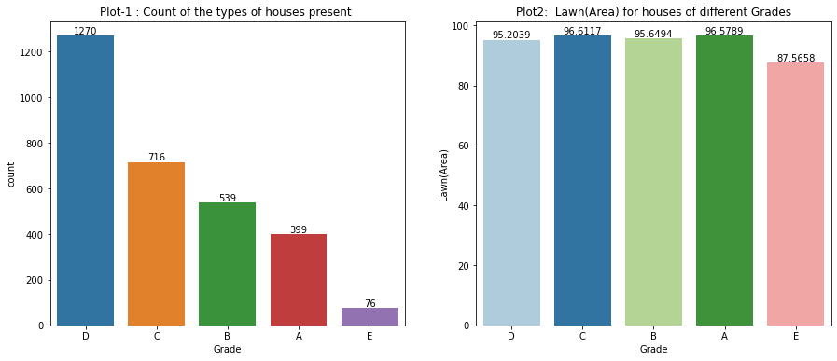
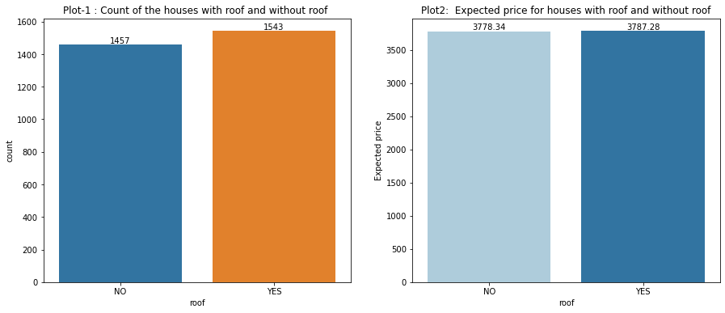
BIVARIATE
Interpretation:-
The Lawn(Area) for the houses with Grade C is more followed by Grade A houses and least for Grade D houses.
There is not much difference in the expected prices for the houses with roof and without roof.

Slide 10
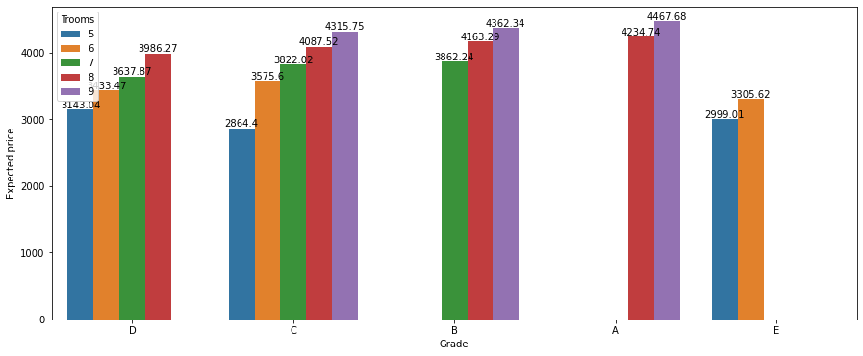
multivariate
Interpretation:-
As the total rooms in a house increases the expected price will also increase with respect to each category.
Although there are second least houses with Grade-A the Expected price are more compared to other grades.
The Grade-D houses are more in number but the ‘Expected price’ is less compared to other Grades.

Slide 11
Model building
For model building I have used 5 algorithms
As the problem statement is ‘Classification’ problem I have used these 5 classification models.
I have used these algorithms to check which model gives the best metrics performance for the given dataset.
1. GAUSSIANNB CLASSIFIER
2. KNEIGHBORS CLASSIFIER
3. DECISIONTREE CLASSIFIER
4. RANDOMFOREST CLASSIFIER
5. XGB CLASSIFIER

Slide 12
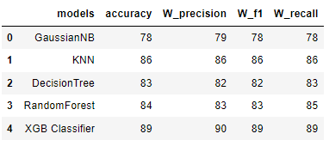
Final Model
From the table we can see the metric performance of all the evaluated models.
After checking the performance of all the algorithms using cross validation technique it is found that the
‘XGB’ algorithm model gives the best ‘Weighted F1_score’.
The Weighted F1_score of the model is 89%.
The performance of the Model is ‘Better'.
After the evaluation of metrics by the XGB model using cross validation technique i further split the data using the holdout method to build the model and carryout the performance of train data and test data and make predictions.
I have split the data by using train test split taking the test size = 30% and random state = 42.
I have fit the train data to the model.
I have checked the Accuracy score for train data and test data.
The Accuracy_score of the train data is 94.19%.
The Accuracy_score of the test data is 90.56%.
For both the train and test data the performance is nearly same and the model performance we can say is 'good'.
I have predicted the ‘Grades’ using the X_test and plotted the graph for actual and predicted Grades.

Slide 13
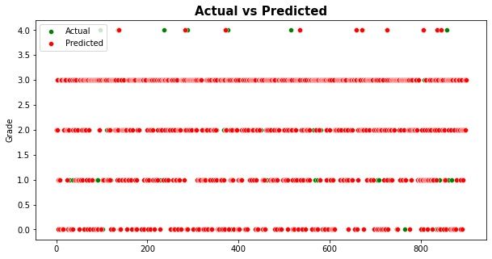
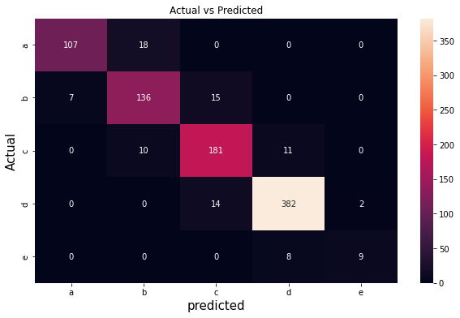
CONCLUSION:-
The actual values and predicted values difference is very less.
Only the Grade-E houses are less overlapped as we can see from the plot.
The Grade-E houses are very less in number so difficult to Predict the grade-E houses.
CONCLUSION:-From the confusion matrix we can see that
The houses are predicted as 'A' Grade are only 107.
The houses are predicted as 'B' Grade are only 136.
The houses are predicted as 'C' Grade are only 181.
The houses are predicted as 'D' Grade are only 382.
The houses with grade 'E' are predicted very less in number that is 9.

Slide 14
BUSINESS CONCLUSION:-
There are more number of houses with Grade D and less with Grade E.
In Grade D houses there are more houses without roof compared to houses with roof.
The expected prices for the houses with roof and without roof doesn’t have much difference.
For the houses in all Grades as the number of total rooms and Twashrooms increase the expected price also increases and the Expected price for the Grade A houses with total rooms 9 is more.
The Lawn(Area) is available more for the houses with Grade C followed by houses with Grade A.
For the houses with more Total rooms and Total washrooms with affordable price go with the Grade D and Grade C houses.
For the people with less income and small family go with the Grade E houses.
For the people with less income and big Family go with the Grade D and Grade C houses.
For the people with high income and require more luxury go for the houses with Grade A.
For the people with high income and doesn’t require any luxury houses go for Grade D and Grade C houses.

Slide 15
Thank you

